Slide 1

Chapter 12: Wave properties
Bishop Stopford School
faith | justice | responsibility | truth | compassion
All work to be done in your exercise book. If you run out of space, start another book.
Print out all worksheets. If you don’t have a printer, write answers in your book using FULL sentences.
ONLINE LEARNING
Print off specification sheet from:
https://bishopstopford.fireflycloud.net/science-2/school-closure-tasks/year-10-1/physics/triple-1/p12-wave-properties

Slide 2
P12 Lessons 4 and 5: More about waves, sound and ultrasound
Week 3 (4th May to 10th May)
Year 10
Triple physics

Slide 3
Learning objectives
What are sound waves and how are they investigated?
Describe ultrasound and its uses.

Slide 4
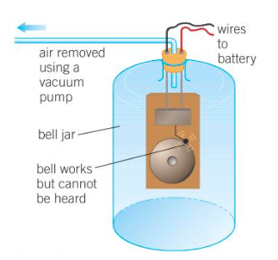
Retrieval
What type wave is a sound wave?
How would you use this piece of apparatus to investigate sound?

Slide 5
Retrieval: Answers
Sound is a longitudinal wave.
Sound does not travel in a vacuum. When air is pumped out of the jar, sound waves no longer have a medium to travel in, therefore the bell cannot be heard.

Slide 6
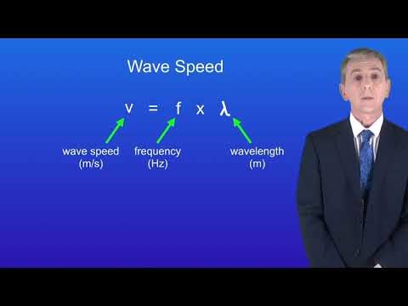
Acquire – watch the video on waves in a solid
Make notes.
Pause or re-watch the video if necessary

Slide 7
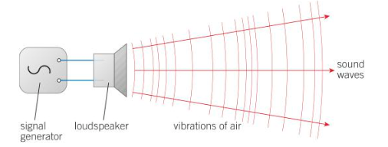
Acquire – Investigating sound waves
This can be done using a signal generator which vibrates at a certain frequency. The signal generator is connected to a loudspeaker which amplifies the sound. The frequency of the sound waves can be controlled by adjusting the settings on the signal generator.

Slide 8

Acquire – echoes
An echo is a sound wave that is reflected from a smooth hard surface. The time between sending a sound wave from a source to hearing the echo is called the time delay. An echo can be used to calculate the speed of sound using the equation:

Slide 9
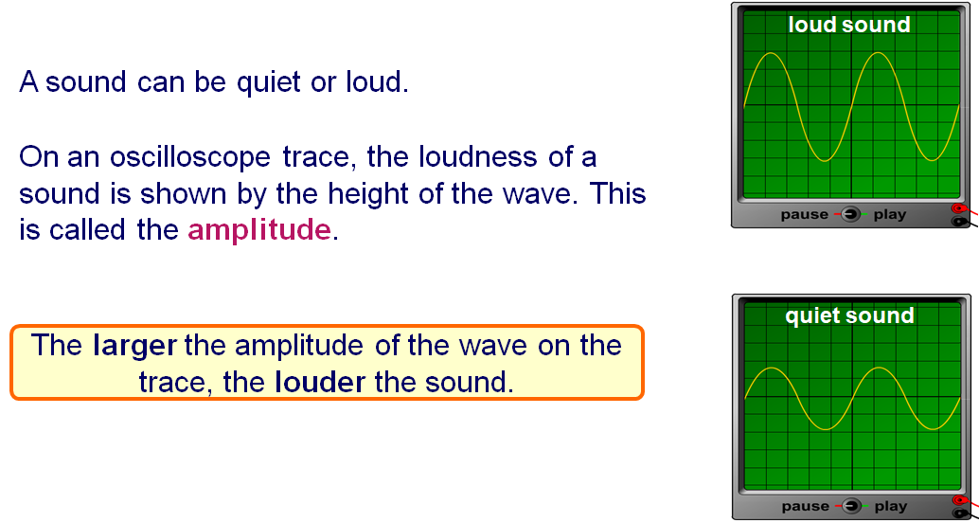
Acquire – loudness and amplitude

Slide 10
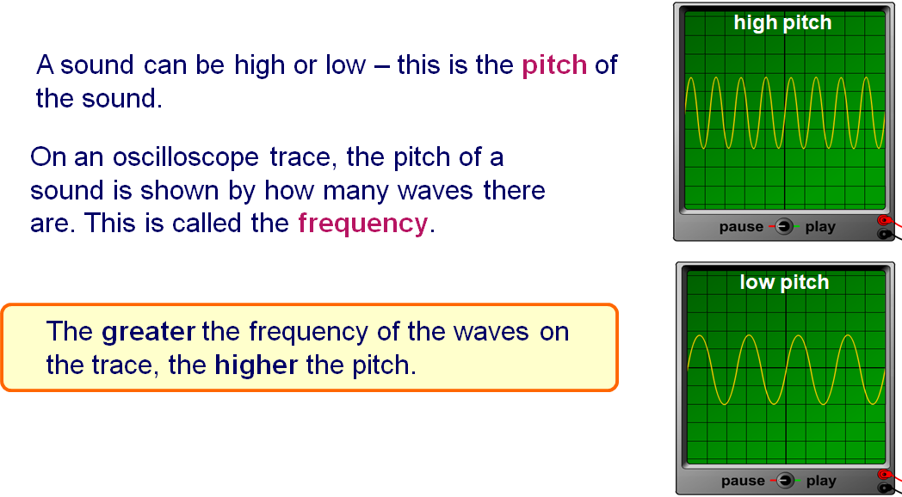
Acquire – frequency and pitch

Slide 11
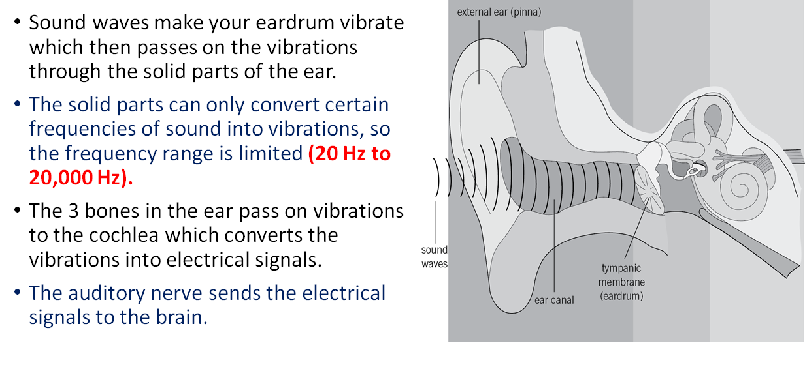
Acquire – human ear

Slide 12
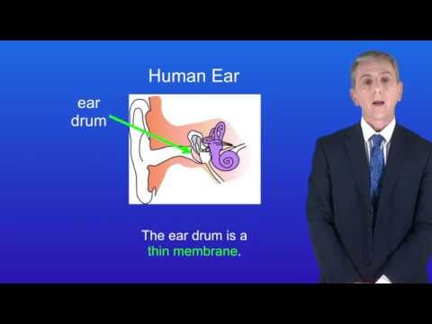
Acquire - Ultrasound
Make notes.
Pause or re-watch the video if necessary

Slide 13
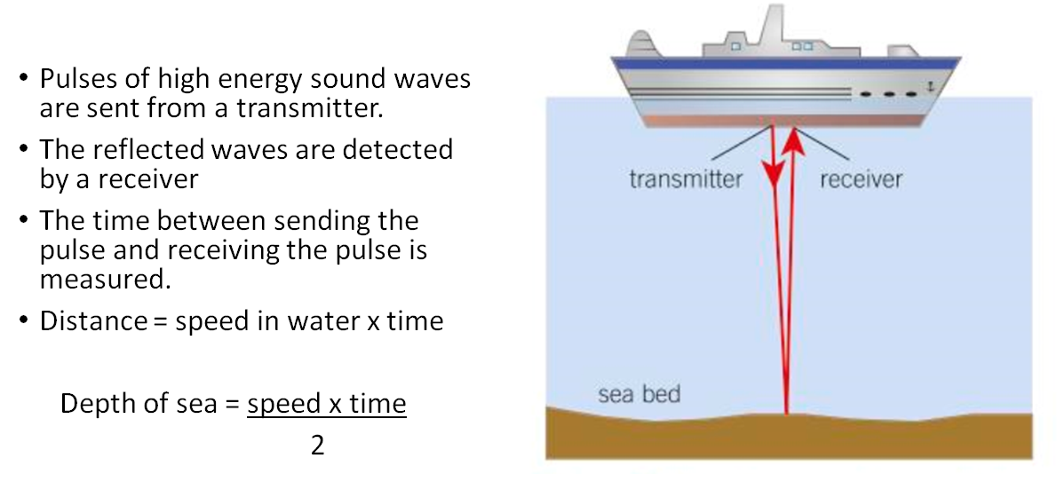
Acquire – uses of ultrasound

Slide 14
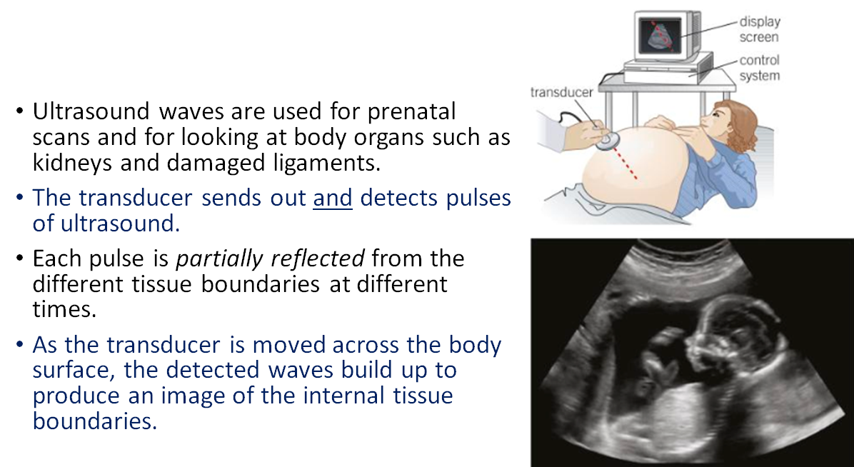
Acquire – uses of ultrasound

Slide 15
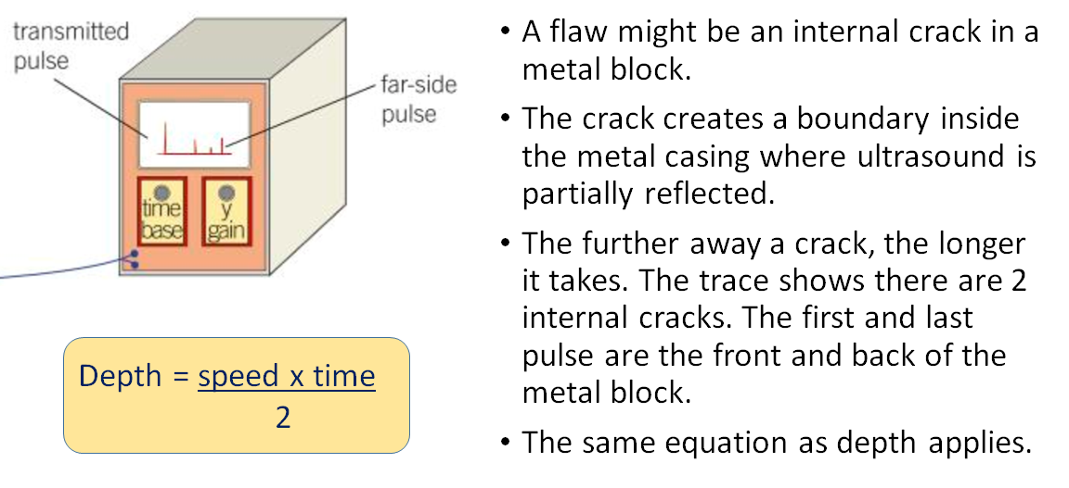
Acquire – uses of ultrasound

Slide 16
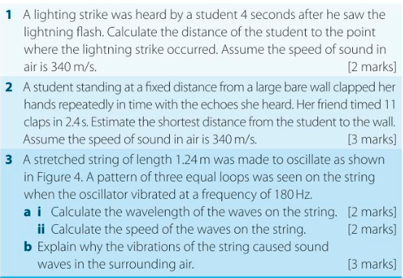
Action

Slide 17
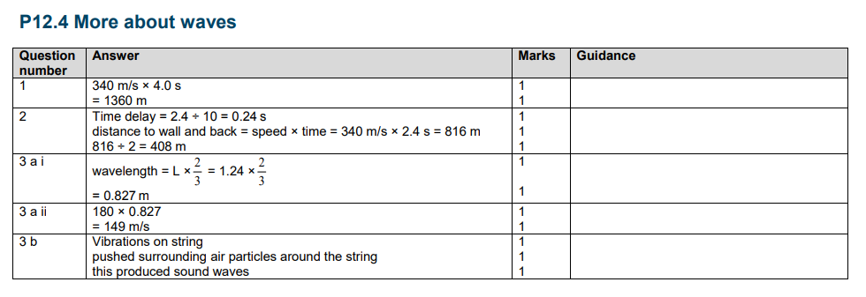
Action – answers

Slide 18
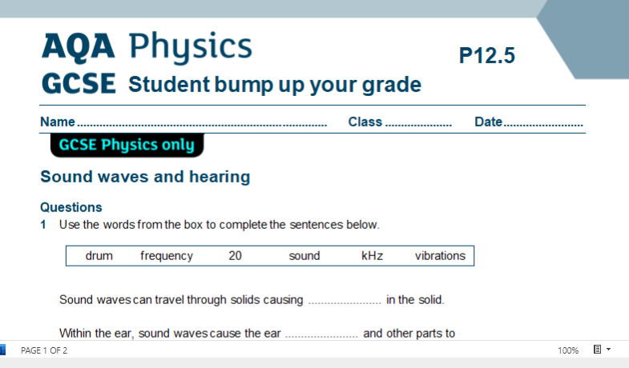
Action – worksheet
Access and print 2 pages per side from:
https://bishopstopford.fireflycloud.net/science-2/school-closure-tasks/year-10-1/physics/triple-1/p12-wave-properties
If you don’t have a printer, write full sentences in your book.

Slide 19
Review
What is the difference between sound and ultrasound?
What defines the loudness and pitch of a soundwave?
Describe 3 uses of ultrasound.

Slide 20
Review – can you….
Describe what sound waves are and how are they investigated?
Describe ultrasound and its uses?

Slide 21
Dig deeper (optional)
Complete the table on advantages and disadvantages of ultrasound. Use the website if you wish https://getrevising.co.uk/grids/using_ultrasound
Advantages | Disadvantages

